Slide 1
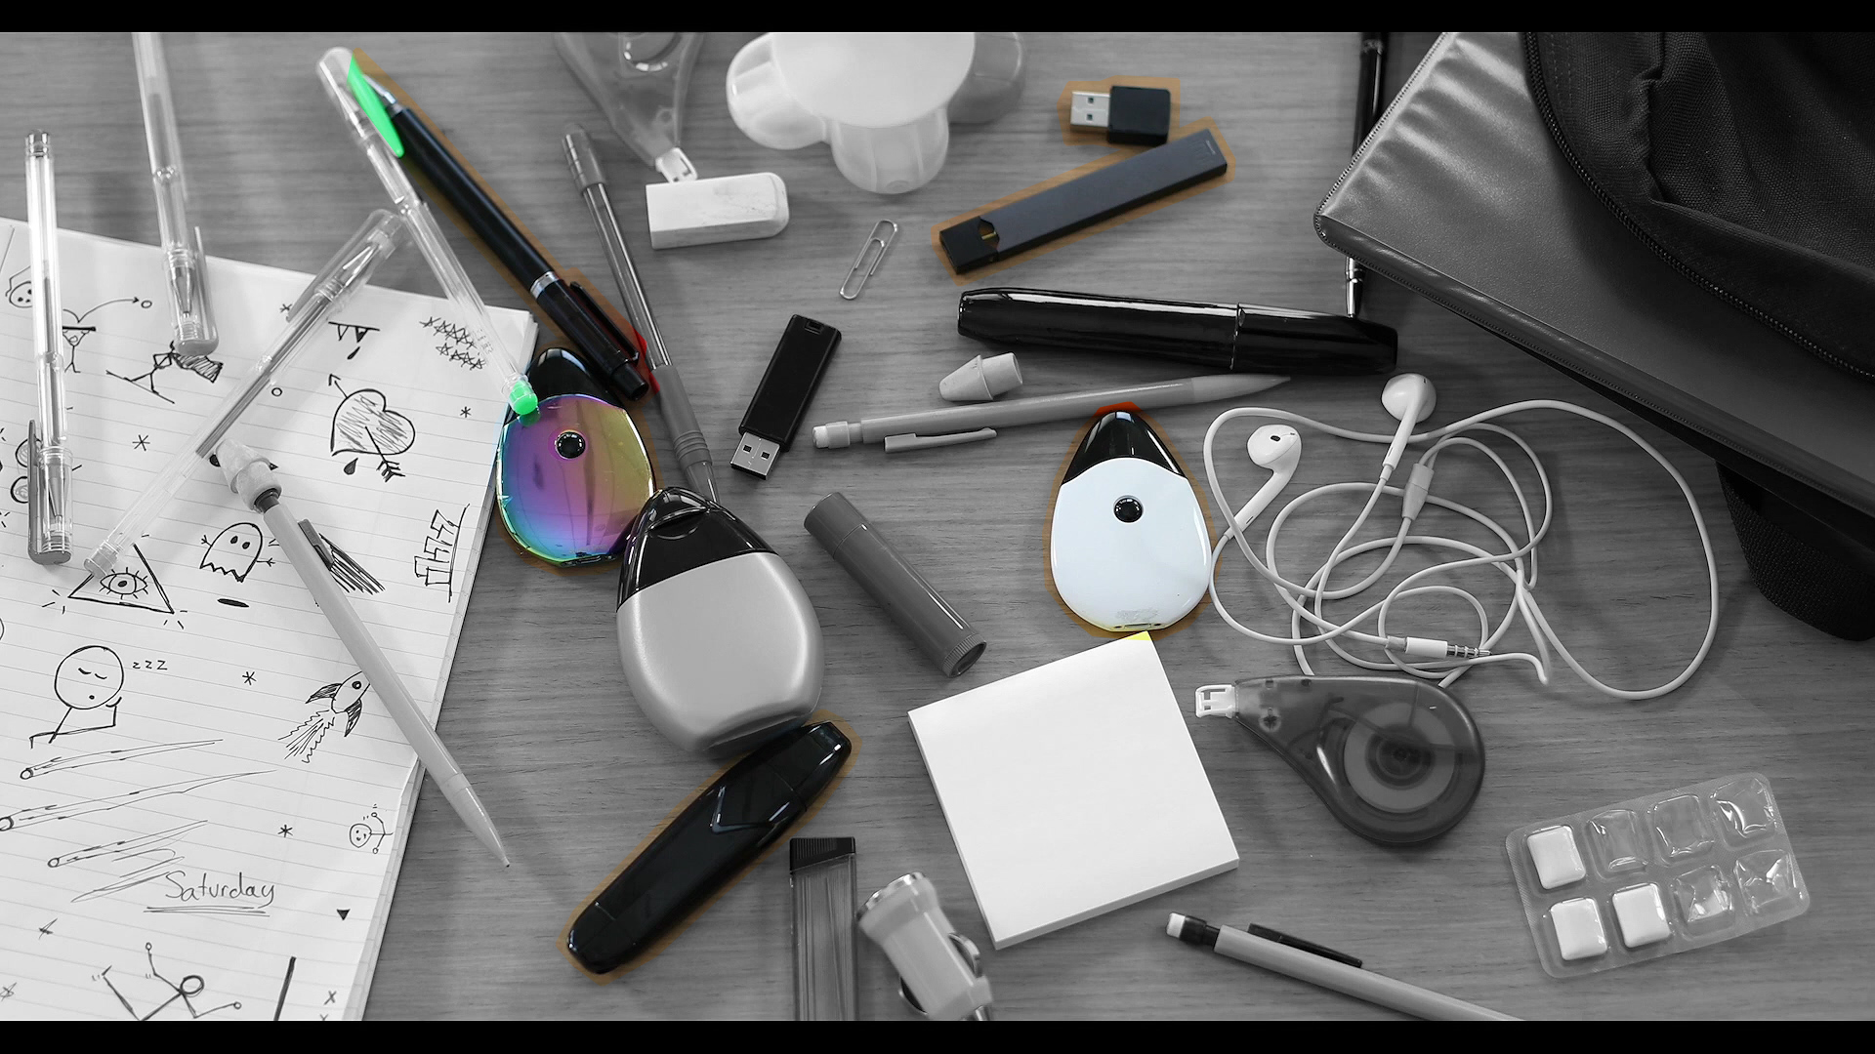
1
4
2
5
3
家中孩子的書包裡
真的只裝學習用品？

Slide 2
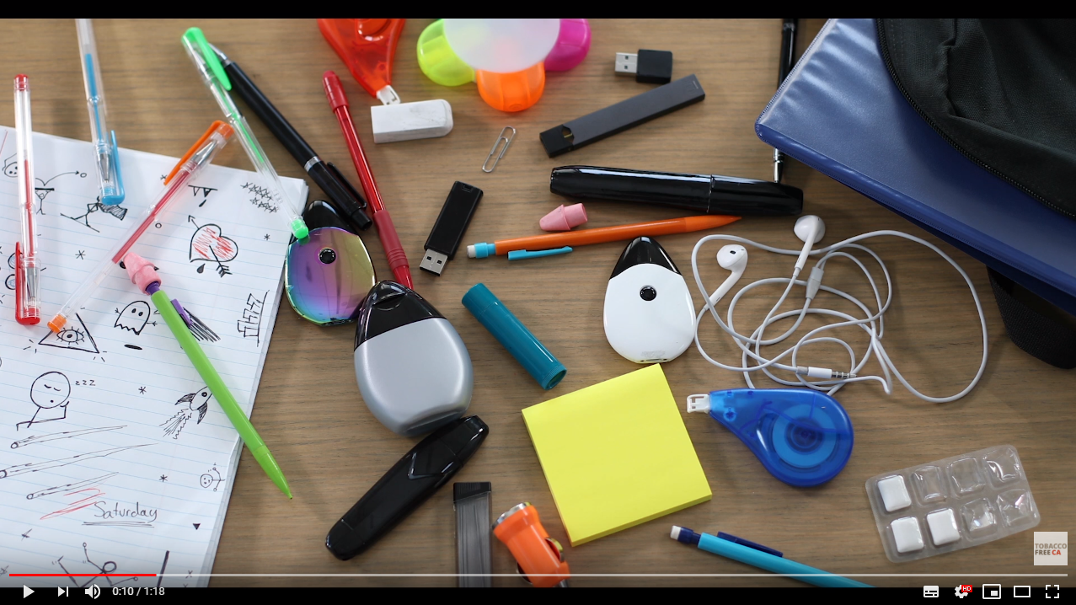
參考資訊連結
https://www.youtube.com/watch?v=-5eN6nssXRM

Slide 3
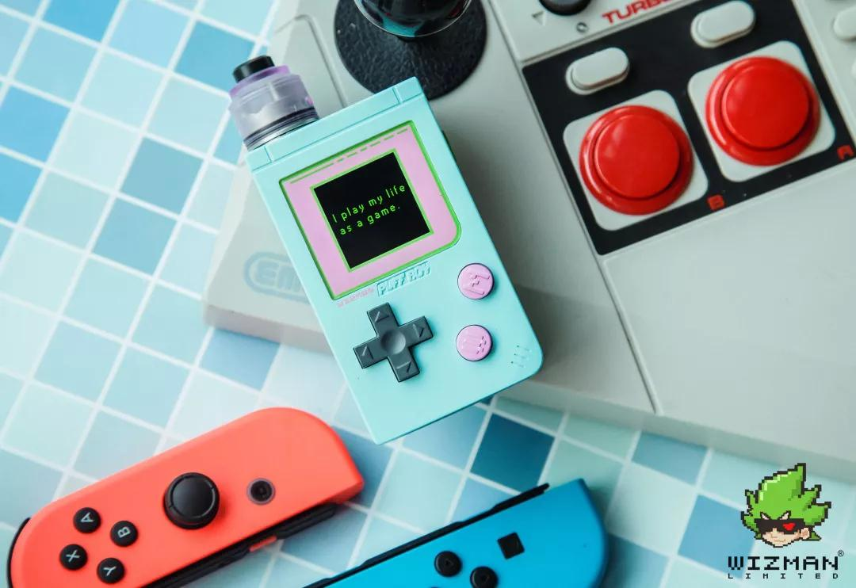
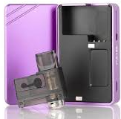
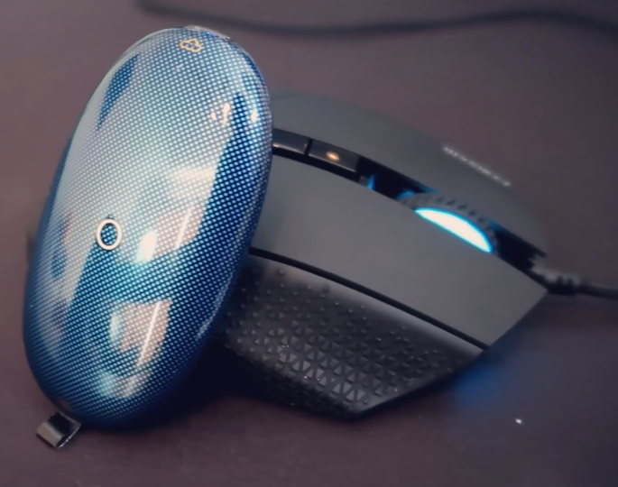
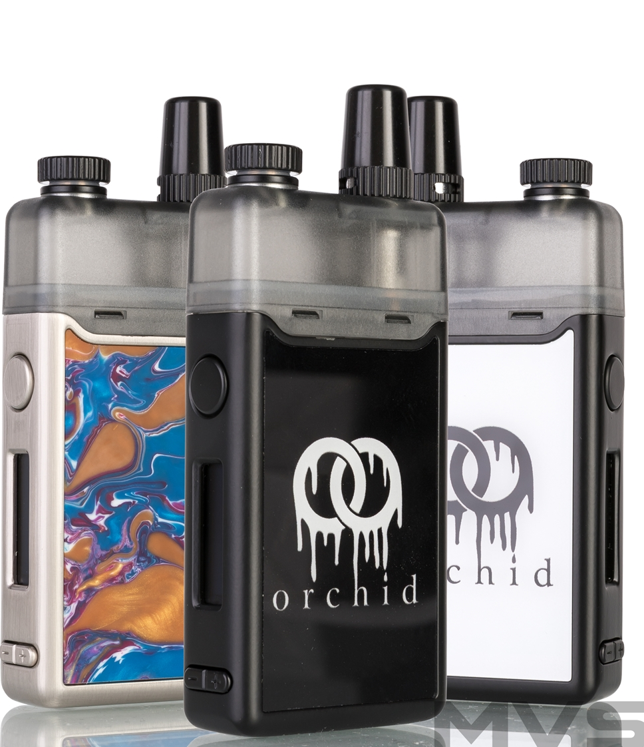
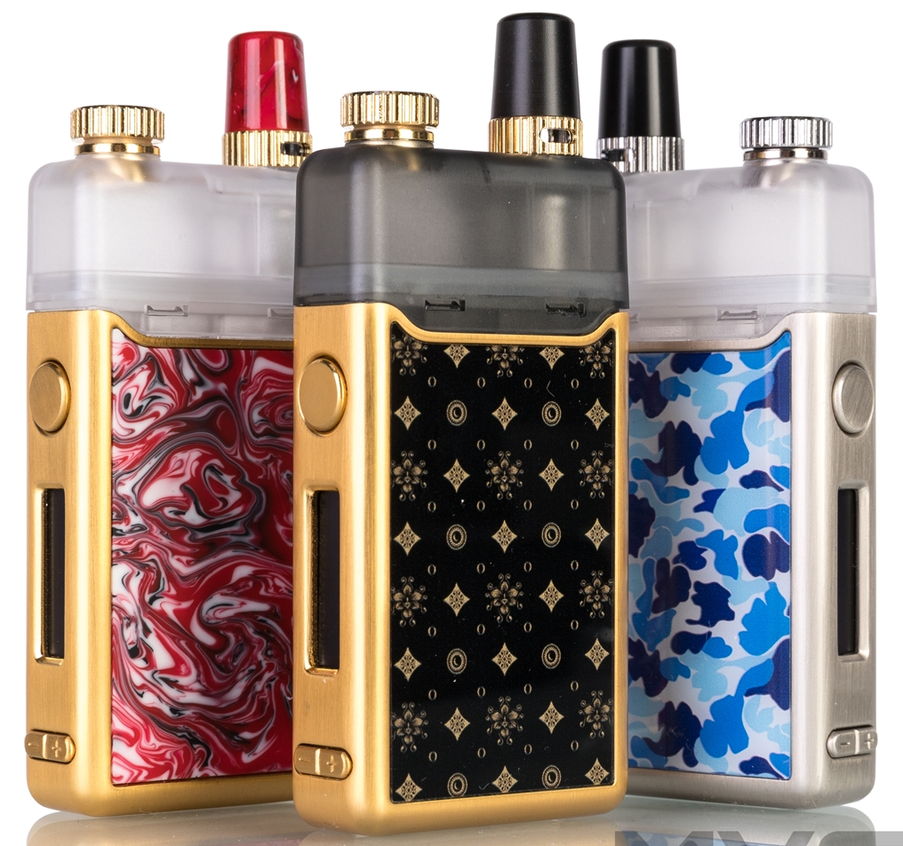
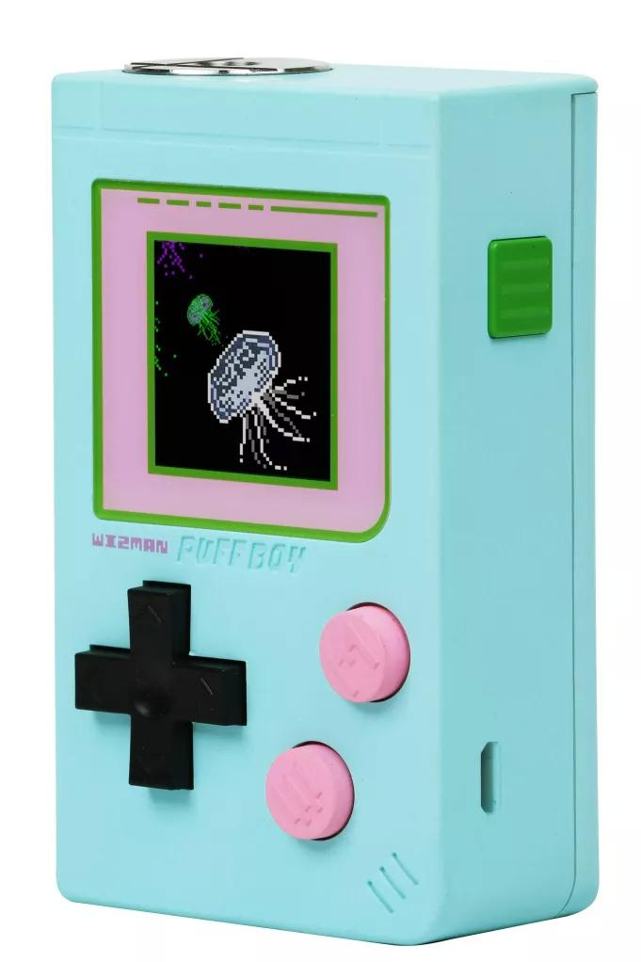
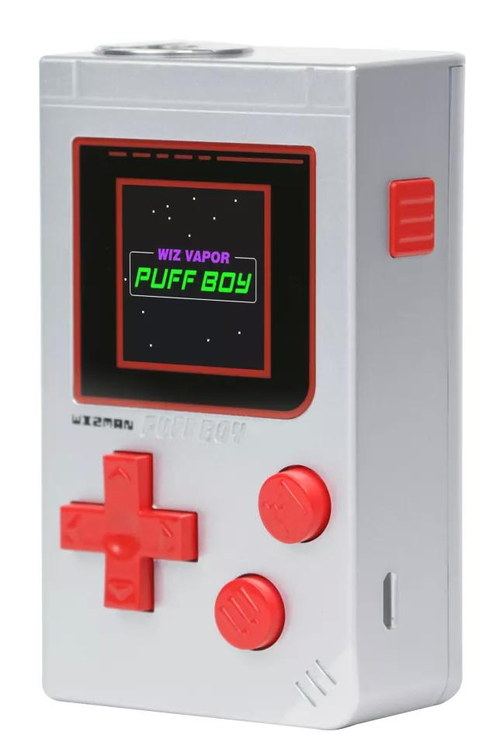
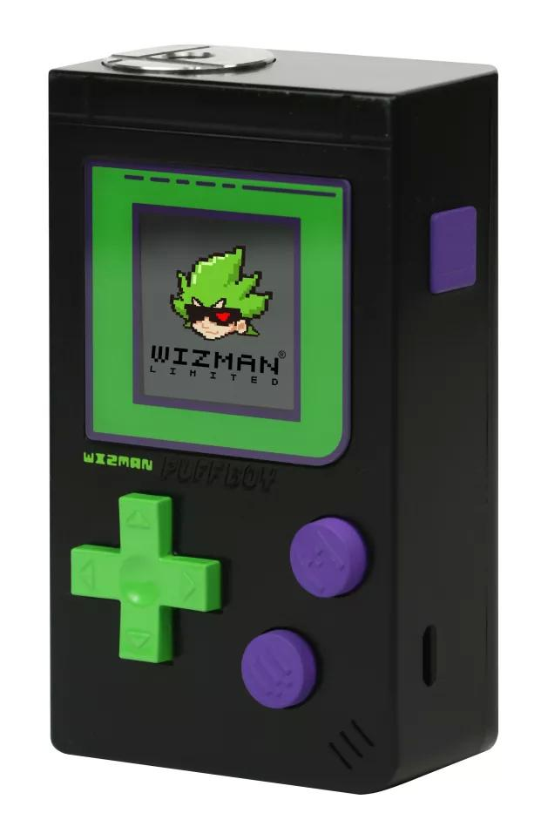
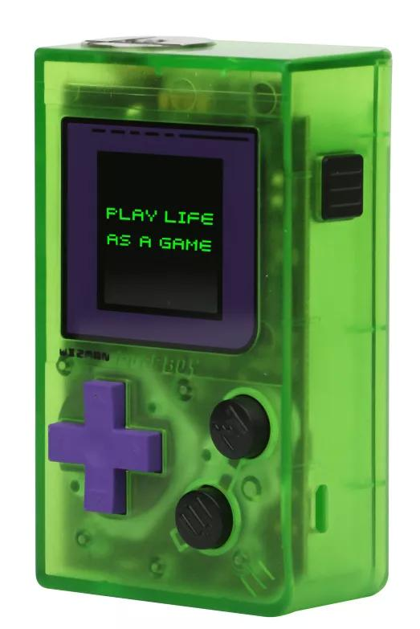
更容易偽裝、拆裝，
易於收藏的新世代產物！

Slide 4
參考資訊連結
Puff Boy
https://www.youtube.com/watch?v=akC1glYiPHU
https://www.vapejoin.com/news/201905/17/5825.html
Dotmod by oncloud
https://www.youtube.com/watch?v=JpchxYUsl8c
https://kknews.cc/zh-tw/news/3vbjzx8.html
https://www.youtube.com/watch?v=85m3DJWxt1k

Slide 5
參考資訊連結
Pal2 動脈2
https://www.youtube.com/watch?v=oDc8-9p0NyI
https://goods.ruten.com.tw/item/show?21528077591209

Slide 6
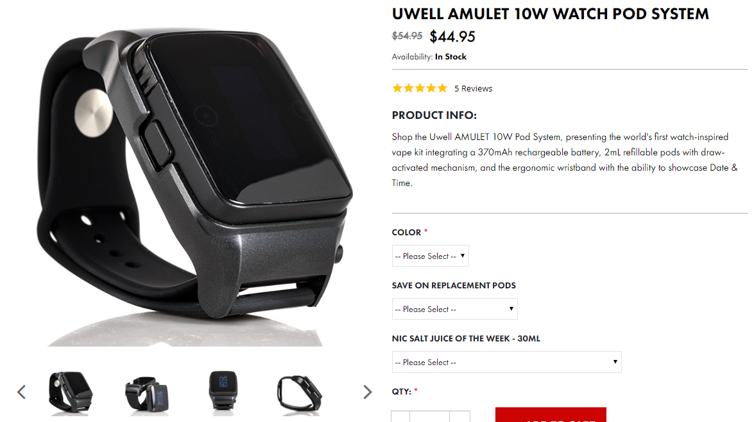
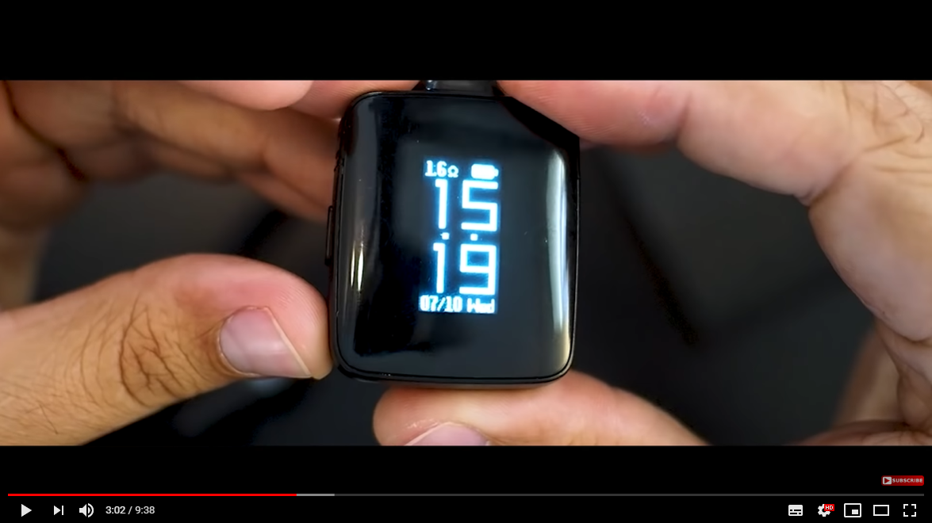
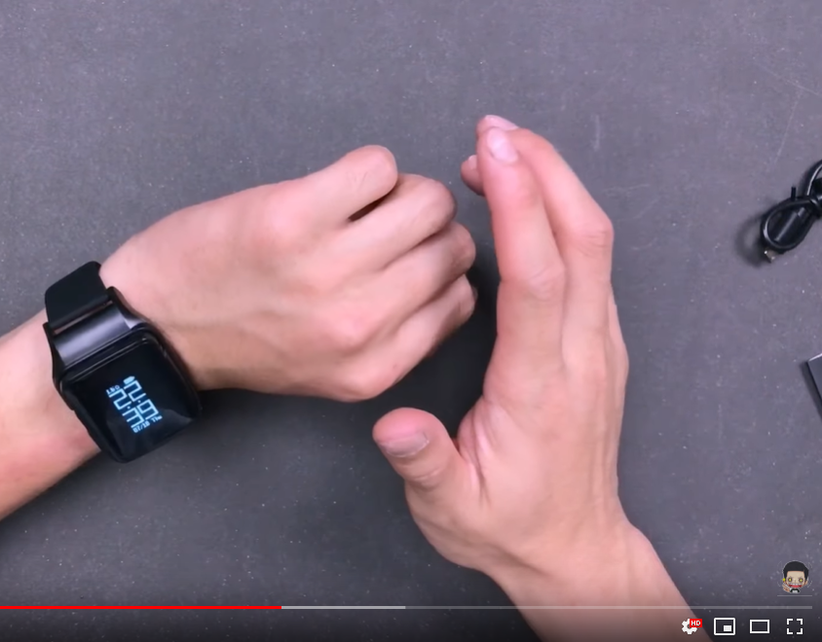
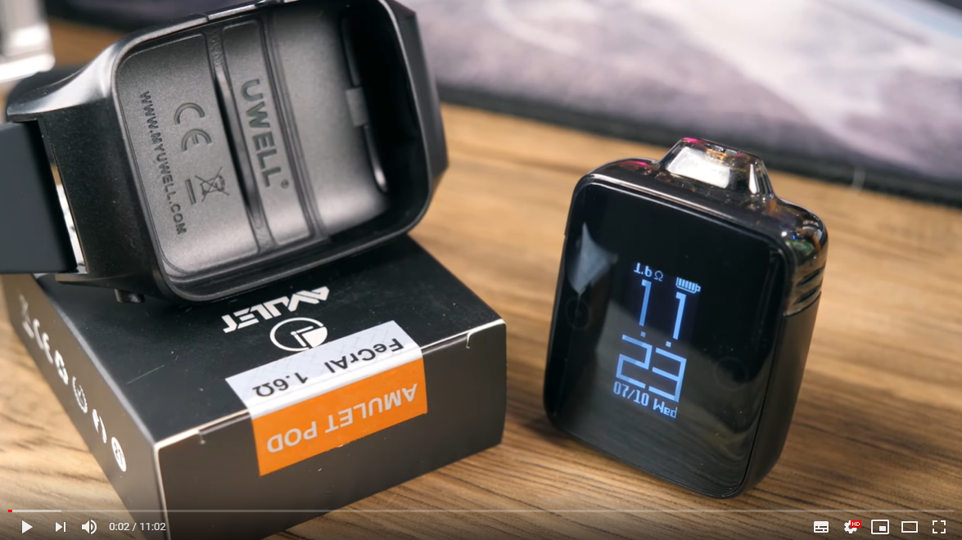
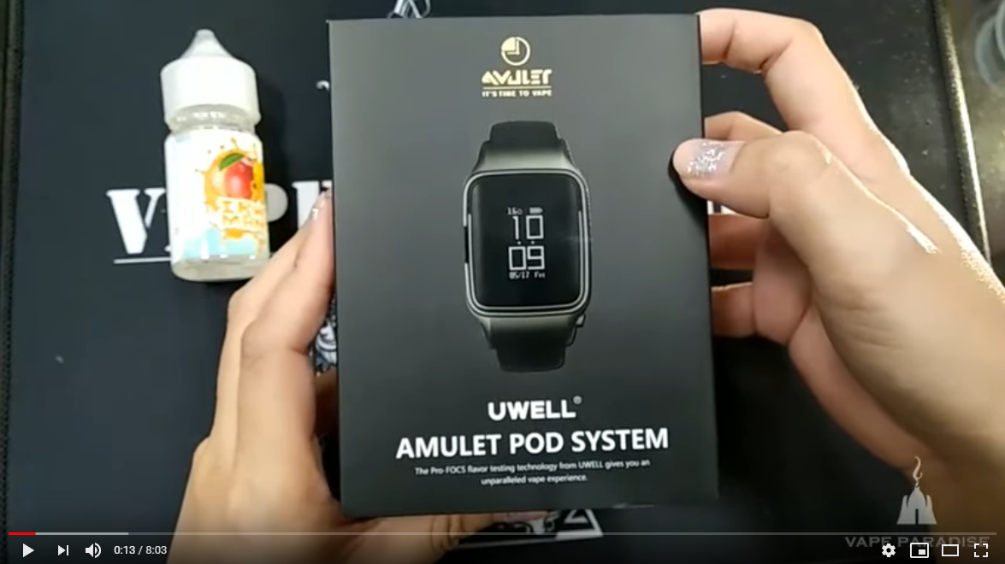
更容易偽裝、拆裝，
易於收藏的新世代產物！

Slide 7
參考資訊連結
Uwell Amulet Pod system
https://www.youtube.com/watch?v=J9XP7RkPVJA
https://www.youtube.com/watch?v=D5GGXDFa63s
https://www.pvtw123.com.tw/products/%E6%96%B0%E5%93%81%E9%A0%90%E8%B3%BCuwell-amulet-pod-vape-watch%E6%89%8B%E9%8C%B6%E5%9E%8B%E4%B8%BB%E6%A9%9F%E5%B0%8F%E7%85%99%E9%9D%9E%E9%9B%BB%E5%AD%90%E7%85%99%E9%9B%BB%E5%AD%90%E8%8F%B8
https://www.youtube.com/watch?v=RnX3BeJijRQ
https://www.youtube.com/watch?v=UfGMA8yxcHQ

